Slide 1
INTERNSHIP DOMAIN: MACHINE LEARNING
Internship Work
on
“UBER DATA ANALYSIS"
Student Name | Mrudula Vasista SS
College Name | East West Institute of Technology
Branch | Information science and Engineering
USN / Reg No | 1EW18IS056
Internship Duration | 4 Weeks ( 1st September 2021to 30th September 2021)
Company Internship Guide | Mr.Ajith koundinya Sir

Slide 2
CONTENTS
About Company
Internship Task
Introduction on Project work / Roles
Software / Hardware Tools Details
Implementation Details
What I Learnt ?
Internship Outcomes
Project Demo / Screenshots
Conclusion

Slide 3

ABOUT THE COMPANY
InfiData Technologies An ISO 9001:2015 Certified IT Company, Accreditated by An International Accreditation Service (IAS). Head quartered in "silicon valley" of India Bengaluru, started in the year 2015. We are highly specialized in the design and development of websites, software application development,mobile app development,E-Commerce solutions and more.Our team of expert professionals works on the latest software tools and technologies to give the best and promising services to our customers.
OUR SERVICES
Development | Training |Consulting
Address:
#1421, 1st Floor,16th B Cross, Sri Radha Building, Opp.To Dr. Agarwal Eye Hospital, Yelahanka New Town, Bengaluru-64
www.infidata.in | info@infidata.in

Slide 4
Internship Tasks
Working with python libraries
Working with ML Algorithms
Activities on Model Building
Project Development with datasets

Slide 5
Software / Hardware Tools DETAILS
Software:
Python 3.6/3.7
Anaconda Navigator
Jupyter notebook
Hardware :
Minimum PC Requirements

Slide 6
INTRODUCTION
The Uber platform connects you with drivers who can take you to your destination or location
This dataset includes primary data on Uber collections with details that include the date, time of travel, as well as information on longitude and latitude in San-Francisco and has operations in over 900 metropolitan areas worldwide.
The prediction of the frequency of trips of data is by implementing a part of k-means clustering algorithm The standard algorithm describes the maximum variance within the group as the number of square distances Euclidean distances between the points and the corresponding centroid.
Mostly focused on interpretation and understanding the concepts in the real world

Slide 7
IMEPLENTATION
In this project , I have applied K-means clustering whose main goal is to group similar elements or data points into a cluster.
For finding the k value , we use Elbow method
We will discuss the use case of how the clustering algorithm used in Uber ridesharing dataset.
Total 6 clusters identified .

Slide 8
IMPLEMENTATION
K-means clustering is one of the simplest and popular unsupervised machine learning algorithms.
A cluster refers to a collection of data points aggregated together because of certain similarities.
First it selects k number of objects at random from the set of n objects. These k objects are treated as the centroids or center of gravities of k clusters.
For each of the remaining objects, it is assigned to one of the closest centroid. Thus, it forms a collection of objects assigned to each centroid and is called a cluster.
Next, the centroid of each cluster is then updated (by calculating the mean values of attributes of each object).
The assignment and update procedure is until it reaches some stopping criteria (such as, number of iteration, centroids remain unchanged or no assignment, etc.)

Slide 9
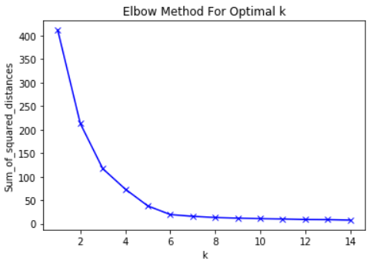
IMPLEMENTATION
The elbow method is used to determine the optimal number of clusters in k-means clustering
The elbow method plots the value of the cost function produced by different values of k
As you know, if k increases, average distortion will decrease, each cluster will have fewer constituent instances, and the instances will be closer to their respective centroids.
The value of k at which improvement in distortion declines the most is called the elbow, at which we should stop dividing the data into further clusters

Slide 10
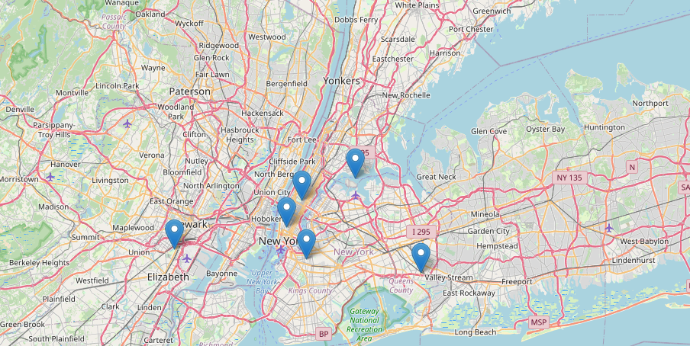
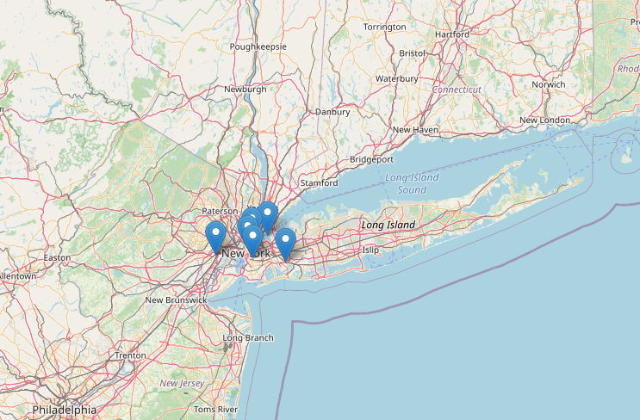
SCREEN SHOTS

Slide 11
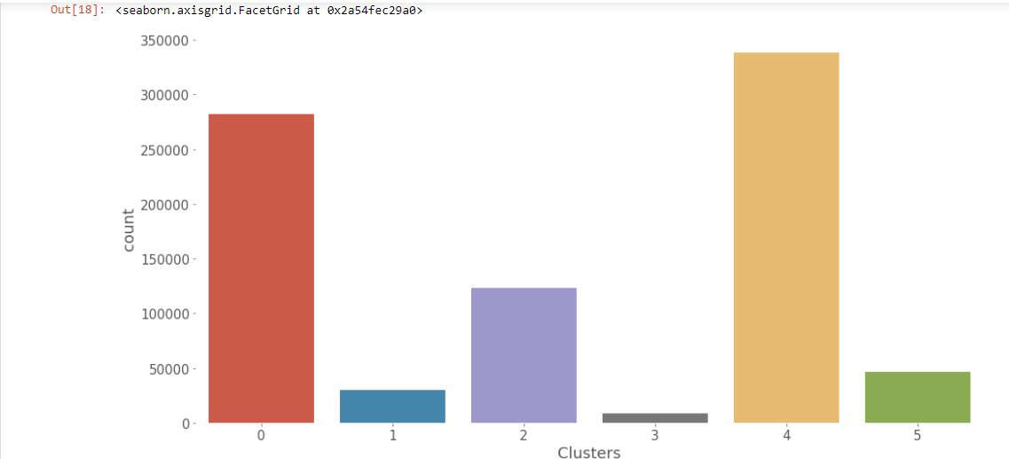
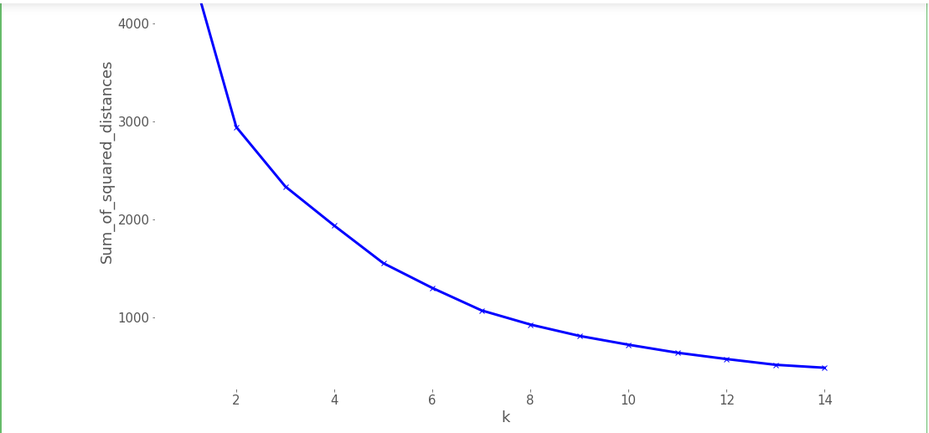

Slide 12
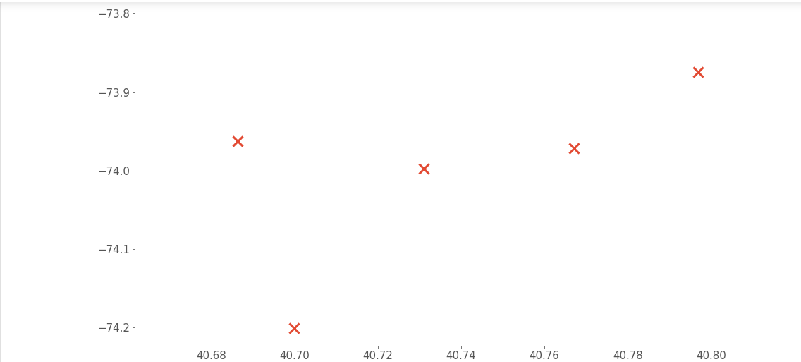

Slide 13
What I learnt ?
Technical skills:
Soft skills:
Management skills:
Python
ML Algorithms
Working with Libraries and datasets
Frameworks
Teamwork in an international working environment
Communication skills
design Working culture
project management,
time management
and more

Slide 14

Internship Outcomes
Now I am able to design applications
Working with SDLC Approach
Growth : Critical Thinking and analysis
Lead the team and projects

Slide 15

CONCLUSION
This internship has been an excellent and rewarding experience.
It was a great opportunity to improve personal and professional skills.
These valuable skills have boosted my professional skills to a higher level and prepare me for future career.

Slide 16


THANK YOU

